Slide 1

Retinal Vessels Segmentation using Deep Learning by CNN
Department of Information Technology
Batch : 05
Team Members :
M.Lingesh ( 211519205086)
D.Manoj ( 211519205090)
V.Lokeshwaran (211519205088)
Guided by Dr.S.Suma Christal Mary M.E., Ph.D
Head of the department
Professor of Information technology

Slide 2
ABSTRACT
The segmentation of retinal blood vessels in the retina is a critical step in diagnosis of diabetic retinopathy. In this paper, we present a new method for automatically segmenting blood vessels in retinal images.
Five basic algorithms for segmenting retinal blood vessels, based on different image processing techniques, are described and their strengths and weaknesses are compared.
A hybrid algorithm that combines the confidence outputs of each basic algorithm is described.
The performance of each algorithm was tested on the DRIVE dataset.
Our hybrid algorithm performs segmentation with similar precision and sensitivity as a trained human observer.

Slide 3
Introduction
The fundus retina image is the only deeper microvascular
system that can be observed non-invasively. The retinal vessel
map contains abundant geometric characteristics, such as
vessel diameter, branch angles, and branch lengths. These
geometric characteristics reflect clinical and pathological
features which are used to diagnose hypertension, diabetes,
and atherosclerosis.
The ophthalmologist uses retinal blood vessels to diagnose vascular and vascular systemlesions related diseases, which interprets diabetic retinopathy (DR) and diabetic maculopathy (MD). These are the leading causes of global blindness. Retinal image assessment has been an indispensable step for the identification of retinal pathology.
Retinal fundus image illustrates retina structure, such asretinal blood vessel tree, optic disk (OD), fovea, macula and abnormal structures.

Slide 4
Problem Definition
This presents a comprehensive review of retinal blood vessel segmentation based on deep learning. The geometric characteristics of retinal vessels reflect the health status of patients and help to diagnose some diseases such as diabetes and hypertension.
The deep learning algorithms have been rapidly applied to retinal vessel segmentation due to their higher accuracy, when compared with anual segmentation and other computer-aided diagnosis techniques .
The obstacles and key aspects for applying deep learning
to retinal vessel segmentation and future indicated
research directions.

Slide 5
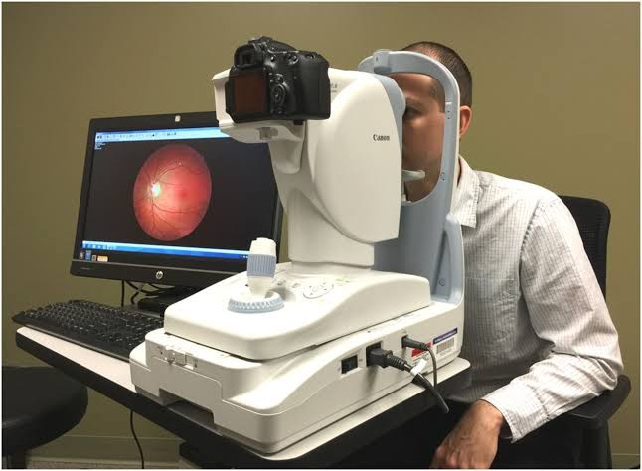
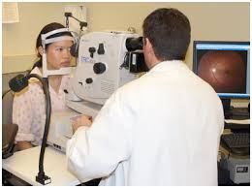
Where is the fundus image obtained ???
Fundus Image Camera
Specialized fundus cameras consisting of an intricate microscope attached to a flash enabled camera are used in fundus photography. The main structures that can be visualized on a fundus photo are the central and peripheral retina, optic disc and macula

Slide 6
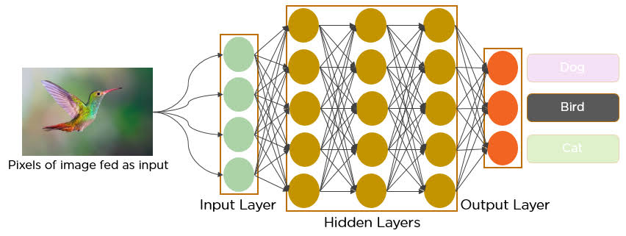
Conventional Neural Networks
A convolutional neural network (CNN or convnet) is a subset of machine learning.
It is one of the various types of artificial neural networks which are used for different applications and data
It is a type of artificial neural network, which is widely used for image/object recognition and classification. Deep Learning thus recognizes objects in an image by using a CNN.

Slide 7
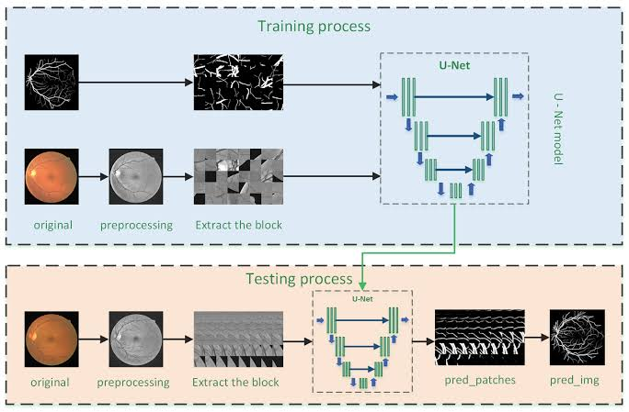
Architecture of CNN by U - NET in Fundus
U-Net is a convolutional neural network that was developed for biomedical image segmentation at the Computer Science Department of the University of Freiburg.
Working Model of U - NET in Fundus Image Segmentation

Slide 8
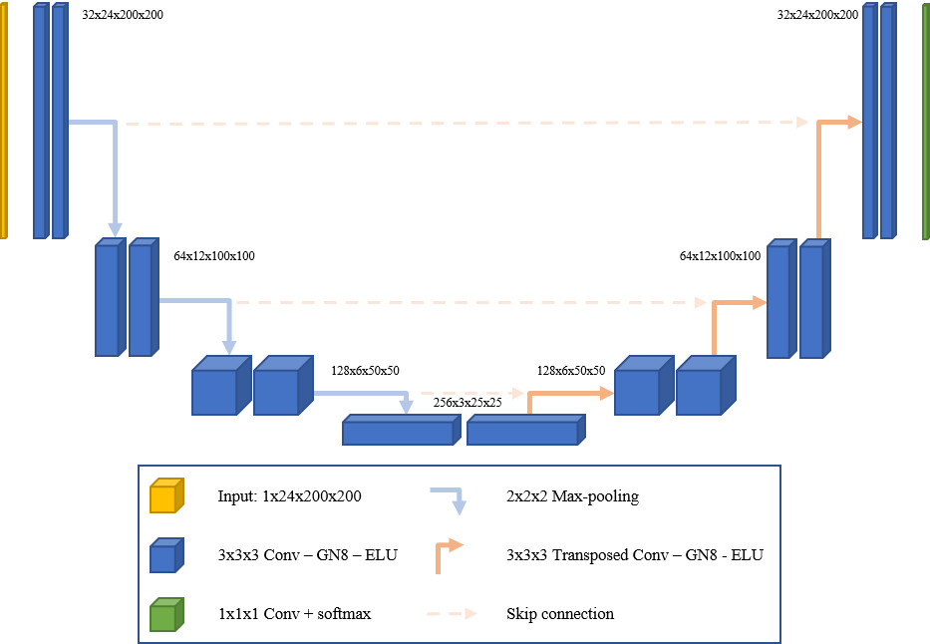
U- Net in PYTorch
UNET is a U-shaped encoder-decoder network architecture, which consists of four encoder blocks and four decoder blocks that are connected via a bridge. The encoder network (contracting path) half the spatial dimensions and double the number of filters (feature channels) at each encoder block.

Slide 9
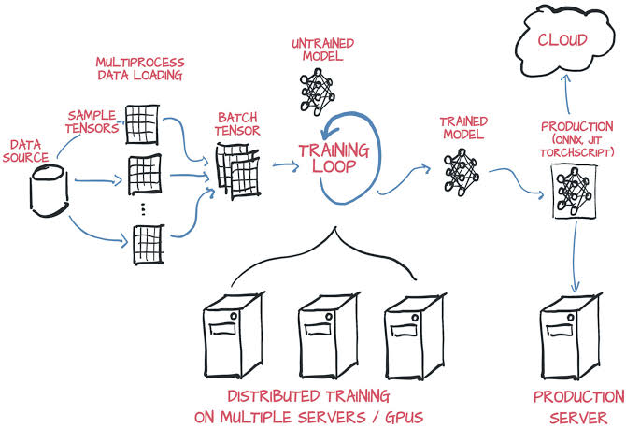
PYTorch / Tensor Flow Implementation
PyTorch is a fully featured framework for building deep learning models, which is a type of machine learning that's commonly used in applications like image recognition and language processing. Written in Python, it's relatively easy for most machine learning developers to learn and use.

Slide 10
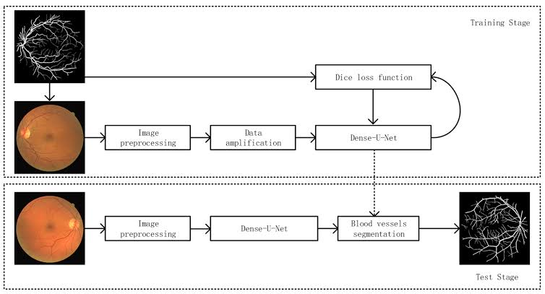
Process of Fundus Segmentation

Slide 11
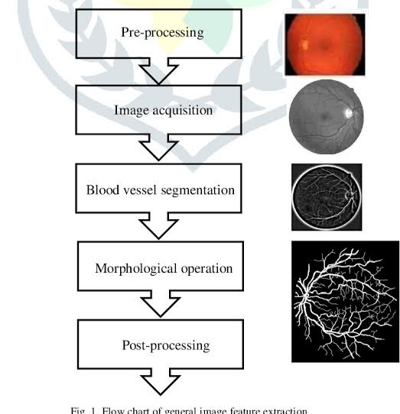
Working Methods of Segmentation

Slide 12
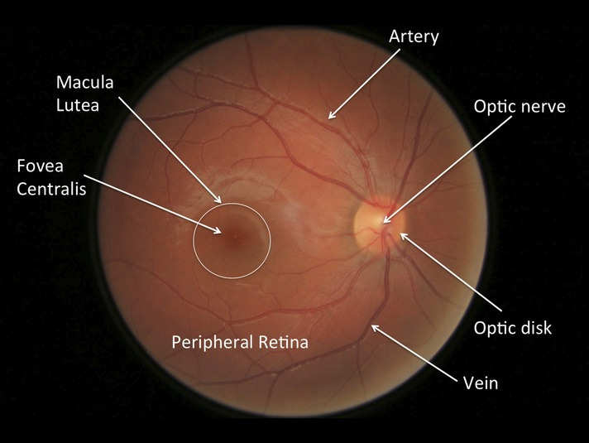
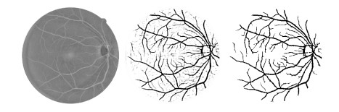
Retina segmentation
Structure of Retina:
Annotated Structure Of Retina :

Slide 13
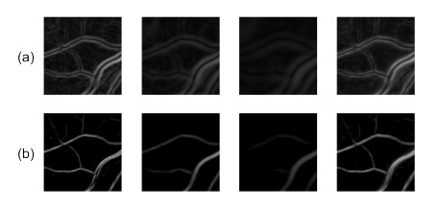
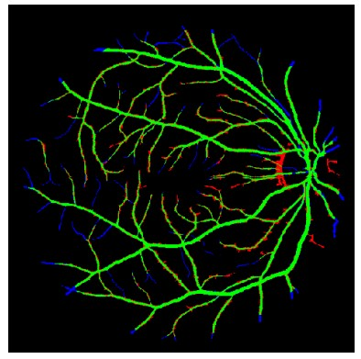
Scale Space Analysis algorithm of Retina
Scale-space analysis for a 100 × 100 portion of a retinal image
Sample result for scale-space analysis algorithm . True positives (green), false positives (red), false negatives (blue), true negatives (black).

Slide 14
Existing System
Earlier, some researchers adopted CNNs with only several
layers to segment vessels. We review 7 CNNs
and summarize their performance evaluations.
Fan and Mo applied a 5-layer CNN to vessel segmentation and extracted image patches in the green channel as
input.
According to the comparison between R, G and B
channels, the green channel provides the best
vessel backgroundcontrast than red and blue channels
They extracted image patches in different channels with different sizes and resized them.
Utilizing multiple channels can provide more information
which is helpful for multi-object classification.

Slide 15
Proposed System
CNN with 6 layers and introduced a reinforcement sample learning scheme that trained the network on samples with poor performance.
The most CNNs have just produced about 94% segmentation accuracy.
CNNs have only several convolutional layers and do
not have strong feature representation capacity, then they can
only segment the basic structure.
Machine learning algorithms require handcrafted features and thus are limited by their generalization ability.
Currently, deep learning models have been greatly
used to image segmentation including retinal images since
they do not need any handcrafted features and outperform
existing unsupervised methods.

Slide 16
Literature Survey
Title | Author | Year | Overview
Retinal blood vessel segmentation based on: International Journal of Advanced Research in Electrical, Electronics and Instrumentation Engineering | Joon huang chuah | 2021 | The approach provides a Deep learning proposed model based on the Convolutional Neural Network (CNN) which was inspired by multi layer image processing .

Slide 17
Literature Survey
Title | Author | Year | Overview
Retinal Blood vessel segmentation | M. L. Rasmussen, R. Bro | 2016 | Retinal vascular geometry and its association to microvascular complications in patients with type 1
Retinal Blood vessel segmentation | A.Triantafyllou, B. Al-Diri , P. Anyfanti | 2015 | Detecting hypertensive retinopathy using retinal vascular geometry,
Retinal Vascular Geometry | T. Y. Wong, J. Sun, R. Kawasaki | 2018 | Guidelines on diabetic eye care: The international council of ophthalmology recommendations for screening, follow-up,.

Slide 18
Literature Survey
Title | Author | Year | Overview
Fundus Segmentation | J. J. Kanski | 2015 | Kanski’s Clinical Ophthalmology: A Systematic Approach on fundus
The productivity loss from uncorrected presbyopia | K. D. Frick, S. M. Joy, D. A. Wilson | 2015 | The global burden of potential productivity loss from uncorrected presbyopia,
Retinal Consultants’ Medical Group (RCMG) Retina Detached Vitrectomy | C. Sinthanayothin, J. F. Boyce, T. H. Williamson. | 2021 | Automated detection of diabetic retinopathy on digital fundus images,

Slide 19
Literature Survey
Title | Author | Year | Overview
Customizing CNN using Ophthalmology | ] J. Flaxel, R. A. Adelman, S. T. Bailey, | 2020 | Diabetic retinopathy preferred practice pattern registered, Ophthalmology
Retinal vessel segmentation using deep learning | C. Chen, J. H. Chuah, R. Ali, and Y. Wang, | 2021 | Real time retinal tracking for fundus image features extraction.

Slide 20
Requirement Specifications
Hardware Requirements :
Intel Processor i5 or above.
8gb Ram
50gb Memory
Windows 10 OS
Software Requirements :
Python Compiler
Mat Lab
Image Processing Tool

Slide 21
Conclusion
Geometric characteristics of retinal vessels reflect clinical
and pathological features.
The ophthalmologist uses vessel maps to diagnose diseases, such as DR and MD.
Precise diagnoses of eye abnormalities and their timely treatment are important in preventing global blindness.
Computerized automatic segmentation for retinal blood
vessels is inspired since manual segmentation of retinal
blood vessels is expensive and time-consuming.
In the past, researchers proposed different methods for automatic retinal vessel segmentation.
Unsupervised models are limited by their accuracy.

